Slide 1
A One Stop Solution focusing on Tourism
7ISR-PIP2001 Capstone Project
Review-1
Batch Number: ISR-G01
ROLL NO STUDENT NAME
20211ISR0078 Bhavana B A
20211ISR0038 Disha R
20211ISR0021 Monika P
Under the Supervision of,
Dr. Alamelu Mangai Jothidurai
Associate Professor
School of Computer Science and Engineering
Presidency University
Name of the Program: B. Tech (Capstone Project)
Name of the HoD: Dr. Zafar Ali Khan
Name of the Program Project Coordinator: Dr. Mohammadi Akheela Khanum
Name of the School Project Coordinators: Dr. Sampath A K / Dr. Abdul Khadar A / Mr. Md Ziaur Rahman

Slide 2
Introduction
Introduction: A tourist guide app that offers car booking, hotel booking, and place recommendations, tailored to user needs.
Many tourists struggle to find all services (booking, recommendations) in one app, leading to inconvenience.
1. Car Booking Users can search, compare, and book rental cars. Filters by car type, price, and availability. Automated booking confirmation with UI Path.
2. Hotel Booking Simple search for hotels by price and location. Booking form with check-in/out and guest details. Automated booking process for confirmations.
3.Cab booking.
4. User-Friendly Interface Clean design with easy navigation. Interactive map for exploring places and getting info and also a quick assistance using chatbot.

Slide 3
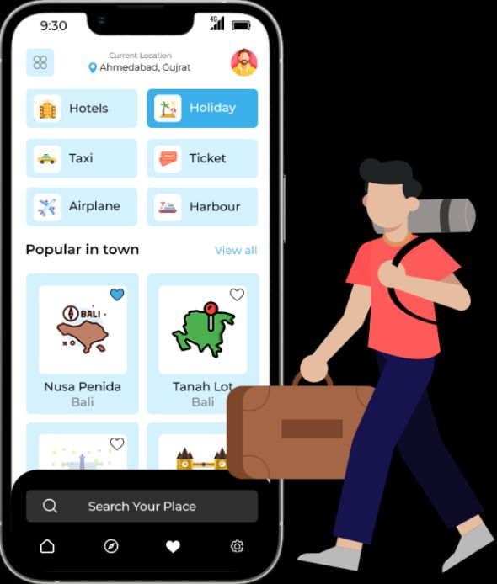
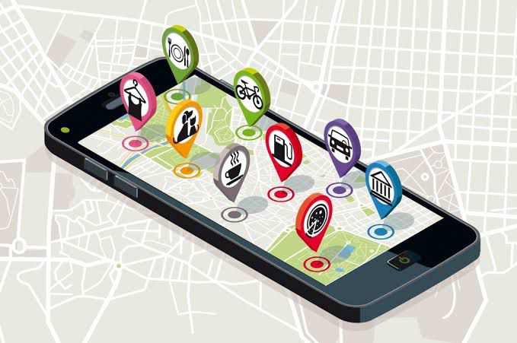

Slide 4
Literature Review
1. E-Tourism and Digital Platforms
2. User Behavior and Expectations in Online Tourism
3. Platform Economics and Business Models in Tourism
4. Emerging Technologies in Tourism
5. Sustainable and Responsible Tourism

Slide 5
Our app:
1. Concept Overview
One-stop solutions in tourism provide a unified platform for multiple services: booking, transport, accommodation, activities, and dining.
Key Idea: Seamless integration and convenience for users (Smith, 2019).
2. Benefits to Tourists
Convenience: All services available in one place, reducing planning stress (Johnson et al., 2021).
Personalization: AI-driven recommendations based on user behavior and preferences (Huang, 2019).
Satisfaction: Higher customer trust and loyalty due to ease of use (Chen, 2018).
3. Technology in One-Stop Solutions
Artificial Intelligence: Personalization and dynamic pricing (Zhang, 2020).
Mobile Apps: Easy access to services anytime, anywhere (Torres, 2021).
Data Analytics: Improving customer experience through user data (Brown, 2020).
4. Challenges
Complexity in Integration: Difficult to manage multiple service providers (Kim et al., 2019).
Data Privacy Concerns: Trust issues surrounding personal data security (Martins & Silva, 2020).Visual

Slide 6
Existing method Drawback
Not able to use more than 1 chrome extension in uipath
Problem in inducing css into uipath.

Slide 7
Proposed Method
Trying various other platforms like firefox for further extensions
Doing more research on implementing css into uipath.

Slide 8
Objectives
The main objective of our project is to provide easy access for various apps * easy room booking with various website access.
* online food booking.
* cab booking
We also aim in providing chatbot for the tourists to ask any queries.
This app can come in 2 languages currently aiming for English and Hindi

Slide 9
Methodology/Modules
Methodology:
1. Project Planning & Requirement Gathering
2. System Design & Architecture
3. Prototyping & UI/UX Design
4. Development & Implementation
5. Testing & Quality Assurance
6. Deployment & Launch
7. Maintenance & Updates

Slide 10
Modules referred:
Modules:
1. User Management Module
2. Search & Recommendation Engine Module
3. Booking & Reservation Module
4. Travel Assistance Module
5. Customer Support Module
6. Analytics & Reporting Module

Slide 11
Architecture
UiPath Studio:
So far, we have successfully implemented data scraping across various websites, including platforms for hotel booking, online food ordering, and cab booking. This approach eliminates the need to install multiple applications, providing users with easy access to a range of services from a single interface. Users can conveniently compare options and make informed choices without the hassle of switching between different apps.
Furthermore:
Design Phase
Workflow Design:
Utilize UiPath Studio to create flowcharts or sequence diagrams that outline the automation process.
UI/UX Design:
If applicable, design user interfaces for any forms or dashboards that will be part of the automation.
Technology Stack Selection
UiPath Tools:
Utilize UiPath Studio for development, Orchestrator for deployment and management, and UiPath Assistant for end-user interaction.
Integration:
Identify other applications (e.g., databases, APIs) that need to interact with UiPath workflows.

Slide 12
.
Data Layer
The data layer is responsible for storing all information related to users, bookings, transactions, reviews, and analytics. This layer also handles caching, indexing, and database management.
Key Databases:
Relational Databases (RDBMS):
MySQL or PostgreSQL for storing structured data like user information, transactions, and booking records.
NoSQL Databases:
MongoDB or Cassandra for storing unstructured data such as user reviews, recommendations, and content.
In-memory Databases:
Redis or Memcached for caching frequently accessed data like real-time flight/hotel availability or user session data.
Data Warehousing:
Amazon Redshift, Google BigQuery, or Snowflake for large-scale data analytics and reporting.
Search Indexing:
Elasticsearch for fast search queries, especially for destination searches, hotels, and activities.

Slide 13
Hardware/software components
Software and Hardware Requirements:
Software Requirements:
Frontend: HTML, CSS, and maybe JavaScript for interactive elements.
Backend: Python (Flask/Django) or Node.js
Database: MySQL or Firebase
UI Path: For process automation where needed.
Hardware Requirements:
Storage
Network Requirements
Peripheral Devices

Slide 14
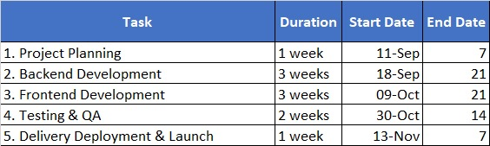
Timeline of Project

Slide 15
Expected Outcomes
An all in all one step app for tourist to get access for
Hotel booking
Online food order
Cab booking
This app avoids installing various application and can provide direct access to websites

Slide 16
Conclusion
the development of a one-stop tourism solution addresses the growing demand for seamless, personalized, and efficient travel experiences. By integrating multiple travel services—such as flight and accommodation bookings, local experiences, dining reservations, and real-time travel assistance—into a single platform, travelers can plan and manage every aspect of their journey with ease.
The solution leverages cutting-edge technologies like artificial intelligence, mobile-first design, and cloud-based architecture to deliver personalized recommendations, enhance user experiences, and ensure scalability. Additionally, the platform's focus on sustainability and ethical tourism aligns with modern travelers' desire for responsible and eco-friendly travel options.

Slide 17
Github Link
https://github.com/monikap384/A-One-Stop-Solution-Focusing-On-Tourism

Slide 18
References
https://www.gousa.in/usa-experiences?no_geo_redirect=true&fy24_in_int_gen_getr_sem_pd_planning=&gad_source=1
https://www.linkedin.com/pulse/deep-dive-uipaths-technologies-application-tourism-sector-edvenswa-bvnfc?trk=organization_guest_main-feed-card_feed-article-content
https://medium.com/@polozdaria/travel-app-case-study-38e3e16b4db

Slide 19
Becken, S. (2017). Sustainable Tourism: An Overview. Tourism Management.
Buhalis, D. (2003). eTourism: Information Technology for Strategic Tourism Management. Pearson Education.
Buhalis, D., & Law, R. (2008). Progress in Information Technology and Tourism Management: 20 Years on and 10 Years After the Internet. Tourism Management.
González, M. A., et al. (2019). Sustainable Tourism and Its Impact on the Local Economy. Journal of Tourism Research.
Hsu, C. H. C., & Huang, S. (2016). Integrating Travel Services and Experience: A New Business Model. Journal of Travel Research.
Huang, T., et al. (2021). The Impact of Augmented Reality on Tourist Experiences. Tourism Management.Kwortnik, R. J., & Thompson, G. M. (2009). Unifying Service Marketing and Operations with Service Experience Management. Journal of Service Research.
Li, X., et al. (2018). Personalization in Tourism: A Study of User Preferences. Journal of Travel & Tourism Marketing.
Mackenzie, S. B., et al. (2020). Artificial Intelligence in the Tourism Industry: The Future of Travel. International Journal of Hospitality Management.
World Tourism Organization. (2021). Global Report on the Trends in Tourism. UNWTO.

Slide 20
Thank You

